Slide 1
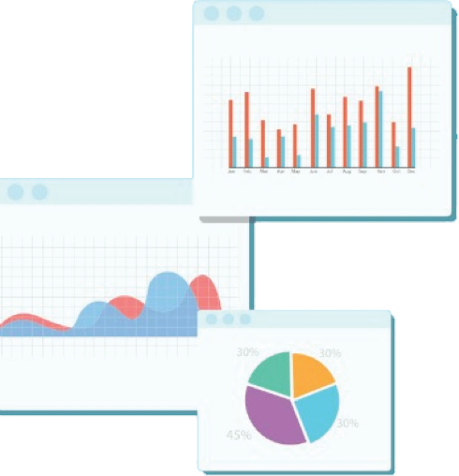

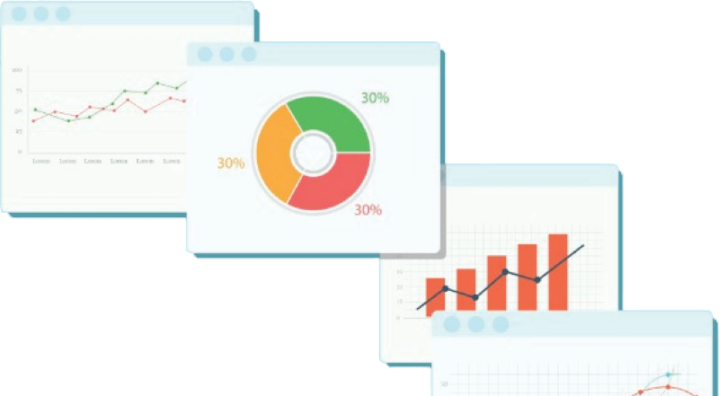
Welcome to Week 11
Lecture 2!
Data Science in Python &
Machine Learning

Slide 2
Neural Networks Review Poll:
Forward Propagation…
Backward Propagation…

Slide 3
Learning Objectives
After this lesson you will be able to:
Identify bias and variance in neural networks
Strategically tune a neural network.

Slide 4
Building & Tuning
Neural Networks

Slide 5
Cheatsheet: Neural Networks in Keras
(Copy or screenshot this slide for reference)
A Keras model follows these main steps:
Instantiate the model type (Sequential for our models)
Add each layer in the order you want them to run
Each layer needs a number of nodes and an activation function (hyperparameters)
1st layer must have defined input size (input_dim=X_train.shape[1])
Last layer:
Nodes = 1 for regression or binary classification, OR the number of target classes for multiclass classification.
Activation must be appropriate to the problem.
‘linear’ for regression
‘sigmoid’ for binary classification
‘softmax’ for multiclass classification
Compile model
Loss appropriate for problem (MSE, BCE, or ‘categorical_crossentropy’)
(optional but recommended) Optimizer (‘adam’ is good!)
(optional but recommended) additional metrics appropriate for the problem type. You can find list of metrics here
Fit model
Training set
Validation set
Epochs
(optional) Callbacks

Slide 6
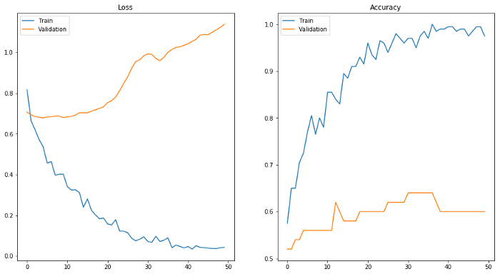
Tuning Neural Networks
Image Source

Slide 7
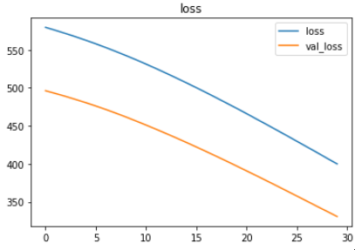
Underfitting (High Bias)
A model that is too simple or trained for too few epochs won’t learn to predict a dataset well.

Slide 8
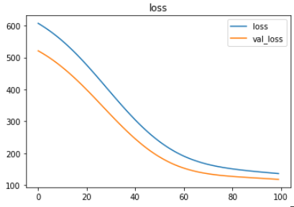
Attacking High Bias
If model still seems to be learning:
Increase epochs
Add nodes
Add Layers
If learning has leveled off:
increase model complexity
Add nodes
Add layers

Slide 9
Attacking High Bias
If Variance is low, attack the bias!

Slide 10
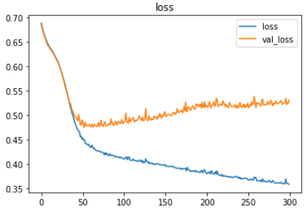
Overfitting (High Variance)
High Variance: model performs worse on test data than on training data.

Slide 11
Overfitting (High Variance)
Neural networks are prone to overfitting
Attacking High Variance:
Dropout Layers
Early Stopping
L1 and L2 Regularization
Decrease model complexity

Slide 12
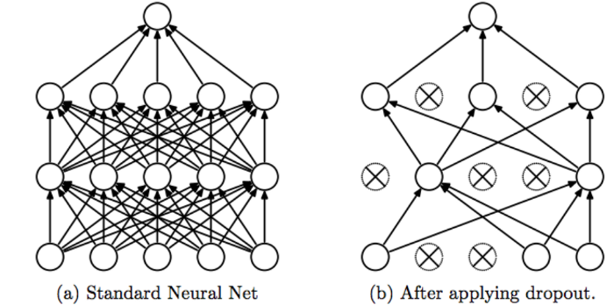
Dropout Layers
What it does:
A dropout layer ‘turns off’ nodes at random in the layer before fit. It turns off different nodes on each epoch.
Why it works:
A network can become overly reliant on a few particular nodes which pick up very specific patterns.
Dropout forces a network to distribute the learning across many nodes and find more generalizable patterns
Image Source:
Srivastava, Nitish, et al. ”Dropout: a simple way to prevent neural networks from
overfitting”, JMLR 2014

Slide 13
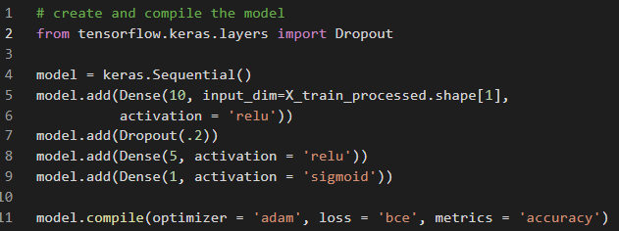
Dropout Layers
How to do it:
Percentage of nodes to ‘drop’ on each epoch

Slide 14
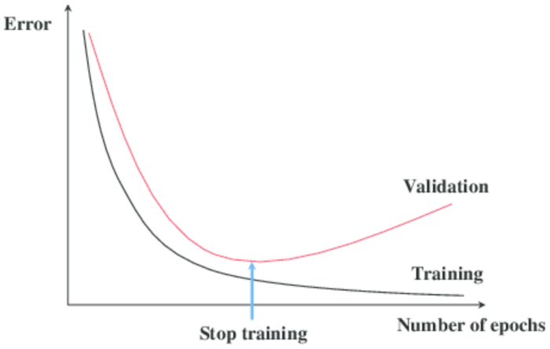
Callbacks: Early Stopping
What it does:
Callbacks are functions that can be called during training. They checks something about the training between epochs.
Early stopping stops training early.
Why it works:
One source of overfitting is over-training. After a certain number of epochs a model will often begin to fit too tightly to training data. It learns TOO well. Early stopping stops the model before that can happen.
Image Source

Slide 15
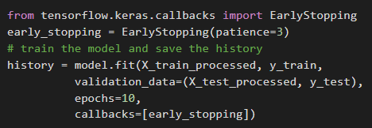
Callbacks: Early Stopping
List of callbacks in fit call (There are many other callbacks you can use!)
If no reduction in validation loss in 3 epochs, stop training
Image Source

Slide 16
Advanced Technique: L1 and L2 Regularization
What it does
Neural network node = linear regression model
L1 and L2 regularization to limit the change in weight values by applying a ‘penalty’ term.
Why it works
Weights can get too large
Model puts too much emphasis on a small subset of features
Regularization L1 and L2 prevent this.

Slide 17
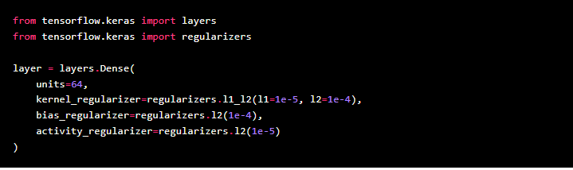
Advanced Technique: L1 and L2 Regularization
How to do it:
Image Source: Keras Documentation

Slide 18
Reduce Model Complexity
What it does:
Reduce the number of nodes and/or layers in your model.
Why it works:
One source of overfitting is a model that is too complex. An overly complex model will fit to the noise in the data rather than the true signal.
How it works:
Create a model with fewer nodes and/or layers.
(Remember to just change one thing at a time when experimenting)

Slide 19
Remember: Always evaluate each model with MULTIPLE metrics.
The best model is the model with the best metrics on test data,
regardless of overfitting!

Slide 20
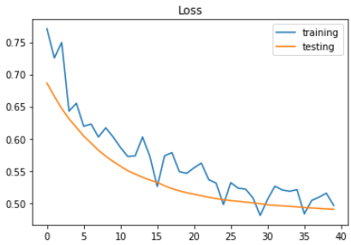
Attack Bias or Attack Variance? (POLL)
Attack Bias or Variance?
bias
How?
Increase complexity (nodes)
Increase complexity (layers)
Train longer

Slide 21
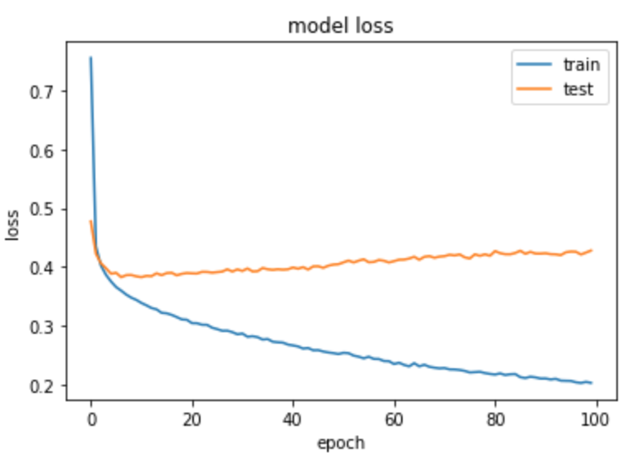
Attack Bias or Attack Variance? (POLL)
Attack Bias or Variance?
Variance
How?
Reduce complexity (nodes and layers)
dropout
L1, l2 Early stopping

Slide 22
Attack Bias or Attack Variance?
High Variance | Low Variance
Attack the Variance | Attack the Bias

Slide 23
Tuning a Model:
Strategies:
More or fewer nodes
More or fewer layers
More or fewer epochs
Regularization
L1 or L2
Dropout layers
Early Stopping
Change activation functions
Change optimizers
And much more!

Slide 24
Let’s Tune a Model Together!
(Code-along)
Code-along Notebook

Slide 25
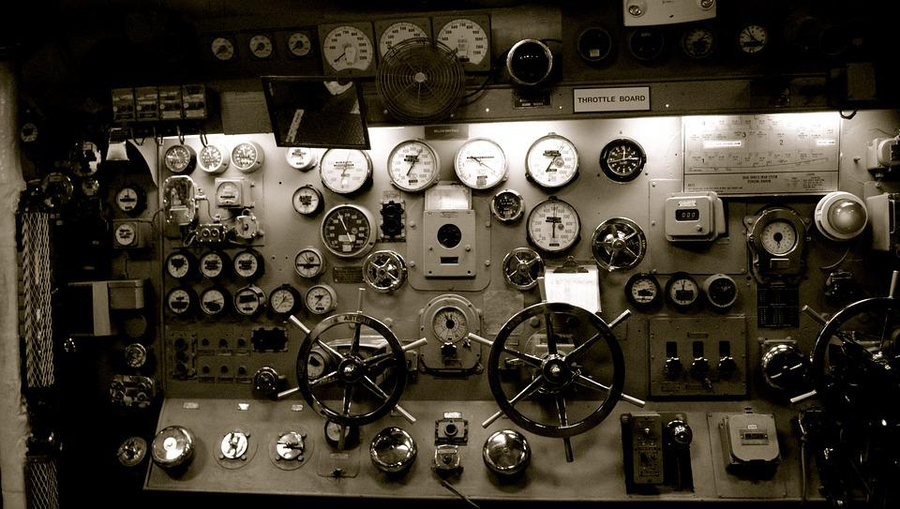
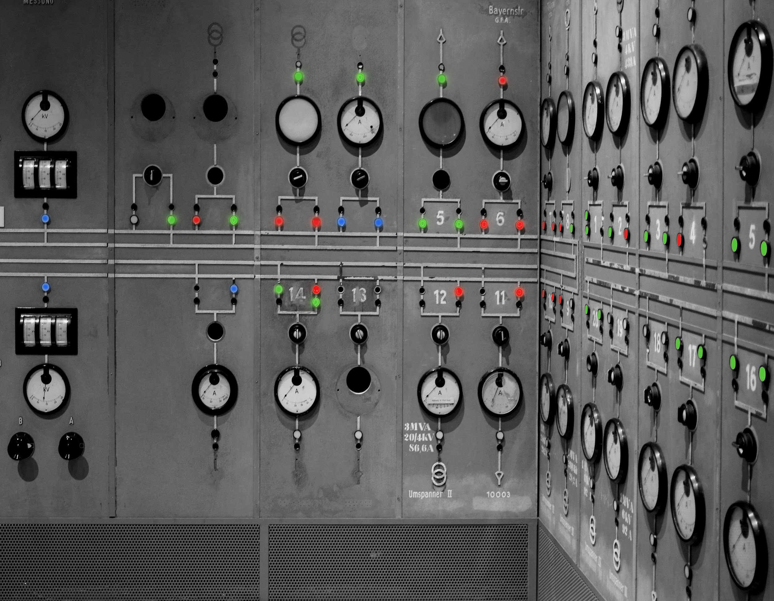
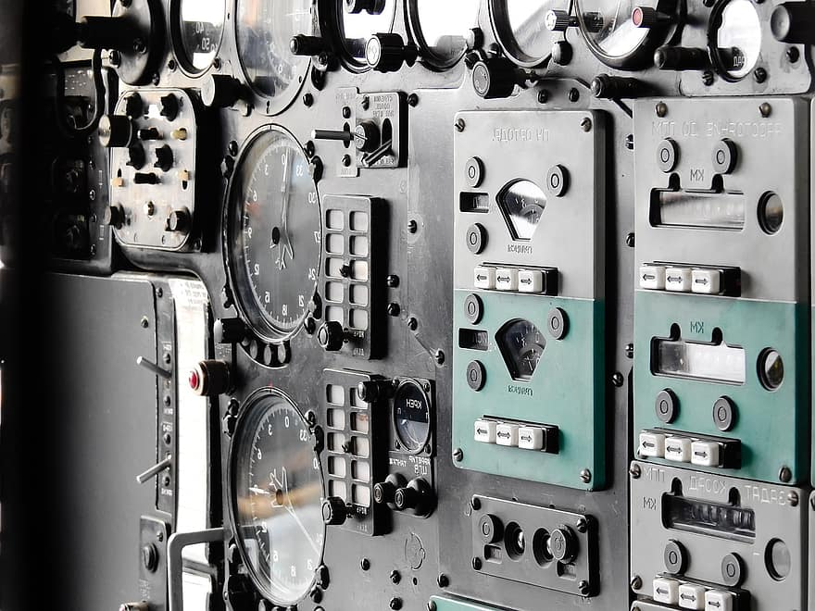
Your Challenge: Tune a Neural Network!
Your task will be to tune the classification model we created in the last lecture.
Make a copy of the notebook
Run the notebooks
Examine the learning plot and decide what you will try with the next model version.
(optional) copy/paste the model code from above and make changes to improve test accuracy
Here is the starter notebook

Slide 26
Announcements: Belt Exam
Belt exam code will be given to the eligible students before Friday evening
To receive a code for this weekend: you must submit by Friday 9 am Pacific:
Week 9 (including all resubmits) and Week 10 assignments
You will be given belt color based on
Black Belt: Your Score >= 9.5
Red Belt: 8.0 <= Your Score <= 9.5
Retake/Rollback: Your Score < 8.0
Everything covered in weeks 9 through 11 will be included in the belt exam,
so you need to review it all.

Slide 27
Announcements: Presentations
Presentations on Thursday next week.
You will find out the order in class on Thursday, so everyone must be ready!
You will have a max of 5 minutes (we will have a timer) so please practice!
Should be aimed at a Non-Technical Audience!
What would a:
non-technical,
non-data scientist,
non-statistician
NOT understand?
TAs can give feedback on READMEs, slides, and they can be practice audiences if you ask them nicely!

Slide 28
Assignments Due:
Neural Network Exercise - Optional Kaggle Competition
Explain your Model Changes
Recommend you submit an entry!
Project 2 - Part 5 - Presentation slides
Remember: NON-DATA SCIENCE AUDIENCE!!!
Daily Schedule

Slide 29
Next Lecture: SQL Queries
Please Read:
Intro to SQL
SQL Alchemy
SELECT and FROM
WHERE
Wildcards (%), and LIKE
Advanced WHERE
ORDER BY and LIMIT

Slide 30
Local Environment Installation
If you haven’t already:
Be sure you get this done before the end of the week
DON’T WAIT UNTIL NEXT THURSDAY/FRIDAY
Get help from instructors and TAs during the week on the Environment Install Discord Channel
Required assignment for next week AND
Critical for first week of Data Enrichment

